Slide 1


Building Robust ETL Pipelines with Azure Data Factory
Mapping & Wrangling Data Flows with API Data

Slide 2
Notes to the Presenter
Slides 4-10 contain notes for the presenter and are hidden.
You may include your picture and company logo on one slide only
It is appropriate to provide a brief background (1 minute or less) on your organization.

Slide 3
Presentation Best Practices
Frame your presentation by answering:
What do you want your audience to learn?
What do you want your audience to do differently?
What result or outcomes do you want your audience to realize?
Clarify your session objectives at the beginning of your presentation.

Slide 4
Presentation Best Practices
A picture is worth a thousands word. A good goals is to aim for 7 words per slide.
Increase attention and interaction by using a variety of communication mediums, such as polls and videos.
Inform PowerBIUG team of plans if using videos, audio, etc. to ensure appropriate AV & room arrangements are made
Plan and follow a rough agenda including a breakdown by minute to help stay on track.

Slide 5
Example of Text Layout
Main topic 1: size 28pt
Size 24pt for the subtopics
Size 24pt for the subtopics
Main topic 2: size 28pt
Size 24pt for the subtopics
Size 24pt for the subtopics
Main topic 3: size 28pt
Size 24pt for the subtopics
Size 24pt for the subtopics

Slide 6
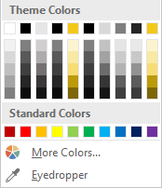
Slide Palette Info
The PowerPoint palette for this template has been built for you and is shown below. Avoid using too many colors in your presentation.
Select the 4th color from the left for subheads and 1st level non-bulleted text color, or wherever “color” text is preferred over the default black/white text
Accent colors 1-6 – (6 Theme Colors to the far right)
Text
Dark 2
Accent 1
Accent 2
Accent 3
Accent 4
Accent 5
Accent 6
Use Accent 1 as the main accent color. Use Accent 2 and Accent 3 when additional colors are needed.
Use Accents 4-6 sparingly – only when more colors are necessary.

Slide 7
Chart Example

Slide 8
Lots of data? Minimalize
Gray is used to de-emphasize data that is less important. Use cool gray 3 or cool gray 7. See slide 7 for color formulas.
All elements have the same interior margins as text blocks.
When a chart or graphic, has more elements than can easily be aligned to the grid, align the outer edges of the group, top, bottom, left and right edges to the grid.
It is preferable to keep the group aligned to the left border.
130M
140M
125M
Other
Other
Other
Other
Other
Other

Slide 9
Chart Example

Slide 10
Notes (hidden)
Some speakers at Microsoft like to use this slide for hidden “notes slides”.
Delete it if you don’t want to use it.
Next: <next slide title>

Slide 11




Tony McGovern
Hacker. Artist. Storyteller. Data lover.
Founder & Data Scientist
emdata.ai
@tonmcg
11

Slide 12
Session Objectives
Show low- and no-code ETL capabilities of Azure Data Factory
12
Notes:
Choose the right Azure machine learning product for the task at hand
- do you need to deploy the model and constantly monitor and update it?
- do you need to choose among a selection of models?
Right-size the Azure machine learning services to fit your data science team
- Are you going to do ETL in Azure Data Factory or in Azure Databricks?
- Which service is right if I only have one data scientist?

Slide 13
Agenda
See the simplicity in building robust, low-code ETL pipeline
Walk through standard data transformations
Use APIs as source data
13

Slide 14
Building Robust ETL Pipelines with Azure Data Factory
Mapping & Wrangling Data Flows with API Data

Slide 15
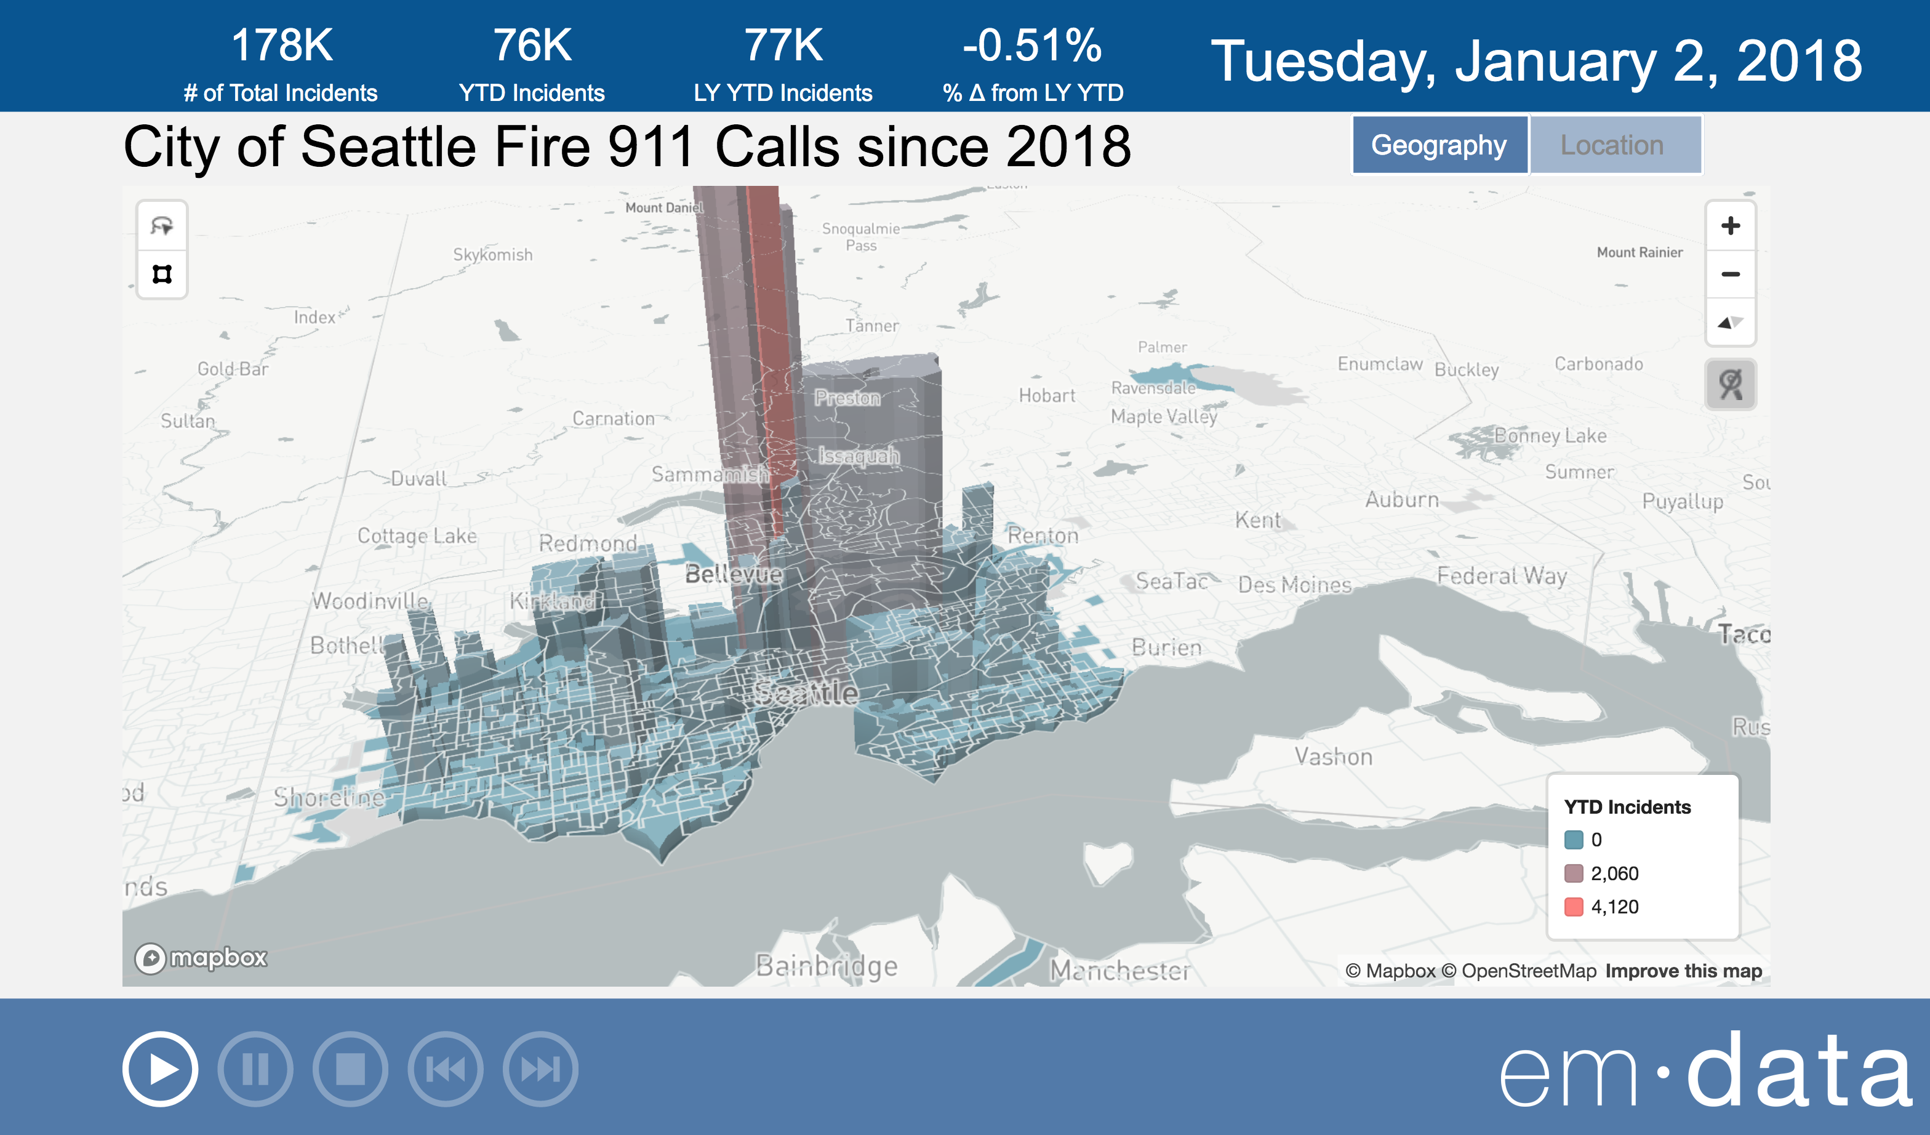

City of Seattle Real Time Fire 911 Calls
15
Notes:
Since I’m only focusing on the first four – and not SQL Server Machine Learning Services – either transition a strikethrough the last point or bold the first four points
Questions:
How does something like Cognitive Services fit into the picture?
Are folks going to ask about ML.NET? https://medium.com/datadriveninvestor/6-reasons-microsoft-has-become-the-go-to-for-machine-learning-e642864ef5f5#425e

Slide 16
Azure Data Factory Concepts
 | AZURE DATA FACTORY | SSIS EQUIVALENT
Feature | Pipeline | Control Flow
Feature | Mapping & Wrangling Data Flow | Data Flow
Connections | Linked Services | Connection Managers
3rd Party | Templates | Components
16
Notes:
Since I’m only focusing on the first four – and not SQL Server Machine Learning Services – either transition a strikethrough the last point or bold the first four points
Questions:
How does something like Cognitive Services fit into the picture?
Are folks going to ask about ML.NET? https://medium.com/datadriveninvestor/6-reasons-microsoft-has-become-the-go-to-for-machine-learning-e642864ef5f5#425e

Slide 17
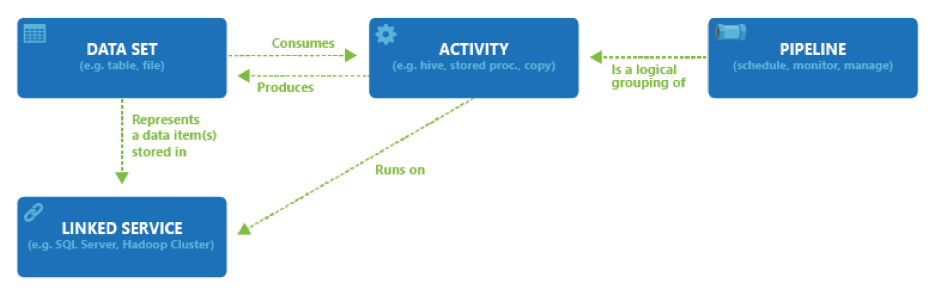
Data flow entities
17
Notes:
Since I’m only focusing on the first four – and not SQL Server Machine Learning Services – either transition a strikethrough the last point or bold the first four points
Questions:
How does something like Cognitive Services fit into the picture?
Are folks going to ask about ML.NET? https://medium.com/datadriveninvestor/6-reasons-microsoft-has-become-the-go-to-for-machine-learning-e642864ef5f5#425e

Slide 18
What Does It Look Like?

Slide 19
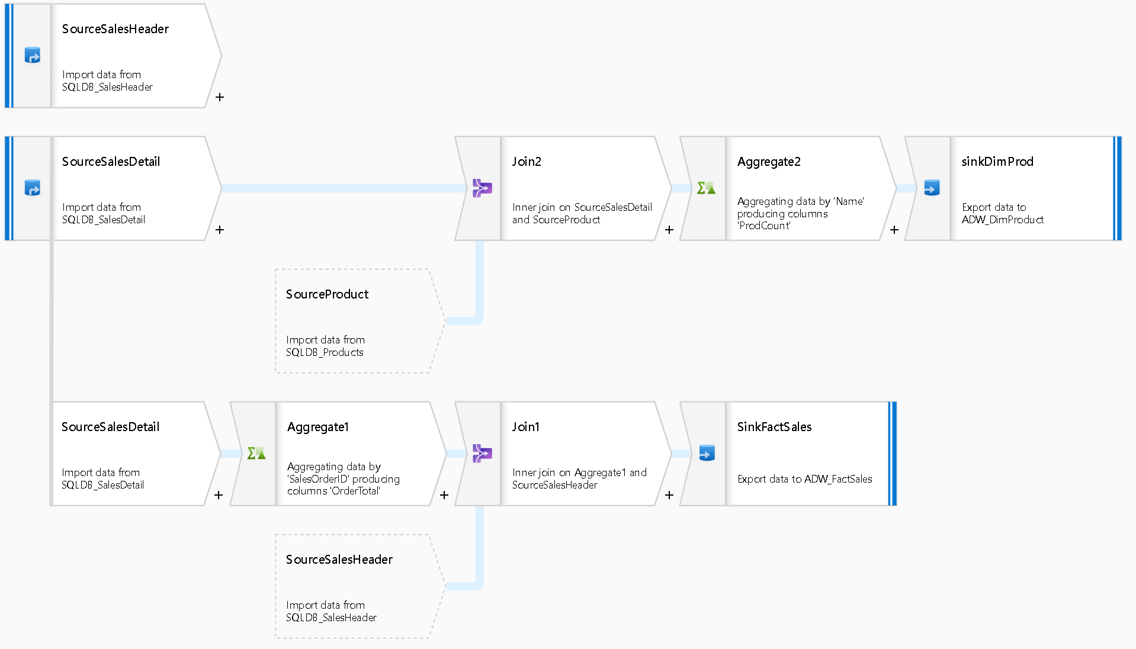
Mapping Data Flow: Load a Star Schema
19
Notes:
Since I’m only focusing on the first four – and not SQL Server Machine Learning Services – either transition a strikethrough the last point or bold the first four points
Questions:
How does something like Cognitive Services fit into the picture?
Are folks going to ask about ML.NET? https://medium.com/datadriveninvestor/6-reasons-microsoft-has-become-the-go-to-for-machine-learning-e642864ef5f5#425e

Slide 20
What Does It Look Like?

Slide 21
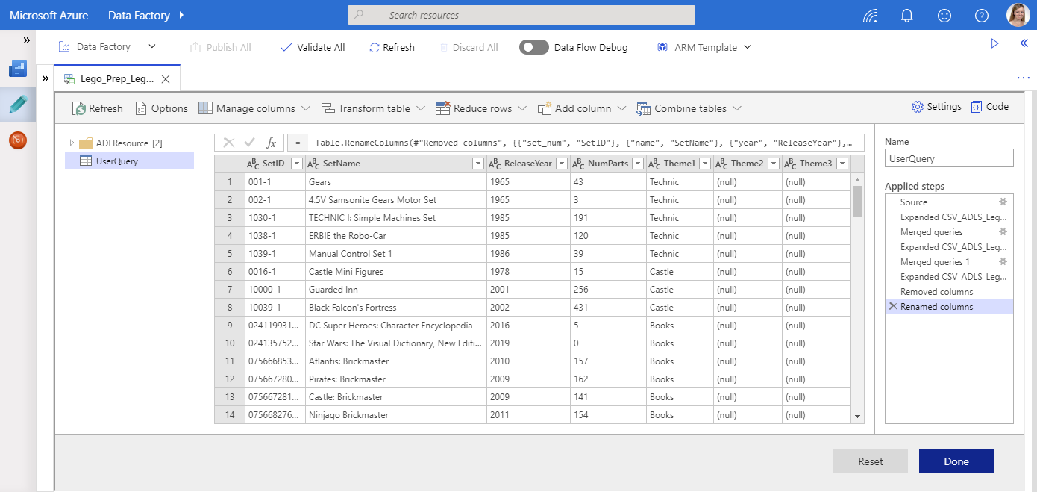
Wrangling Data Flow: Power Query at Scale
21
Notes:
Since I’m only focusing on the first four – and not SQL Server Machine Learning Services – either transition a strikethrough the last point or bold the first four points
Questions:
How does something like Cognitive Services fit into the picture?
Are folks going to ask about ML.NET? https://medium.com/datadriveninvestor/6-reasons-microsoft-has-become-the-go-to-for-machine-learning-e642864ef5f5#425e

Slide 22
What Does It Look Like?

Slide 23
Questions?

Slide 24
Resources
Tutorial Videos: http://aka.ms/dataflowvideos
Patterns
http://kromerbigdata.com
http://mssqldude.wordpress.com
http://aka.ms/dataflowpatterns
Documentation: https://docs.microsoft.com/en-us/azure/data-factory/concepts-data-flow-overview
Expression Language: http://aka.ms/dataflowexpressions
Comparing Mapping and Wrangling Data Flows: https://www.cathrinewilhelmsen.net/2019/05/13/comparing-mapping-wrangling-data-flows-azure-data-factory/
24

Slide 25


